Slide 1
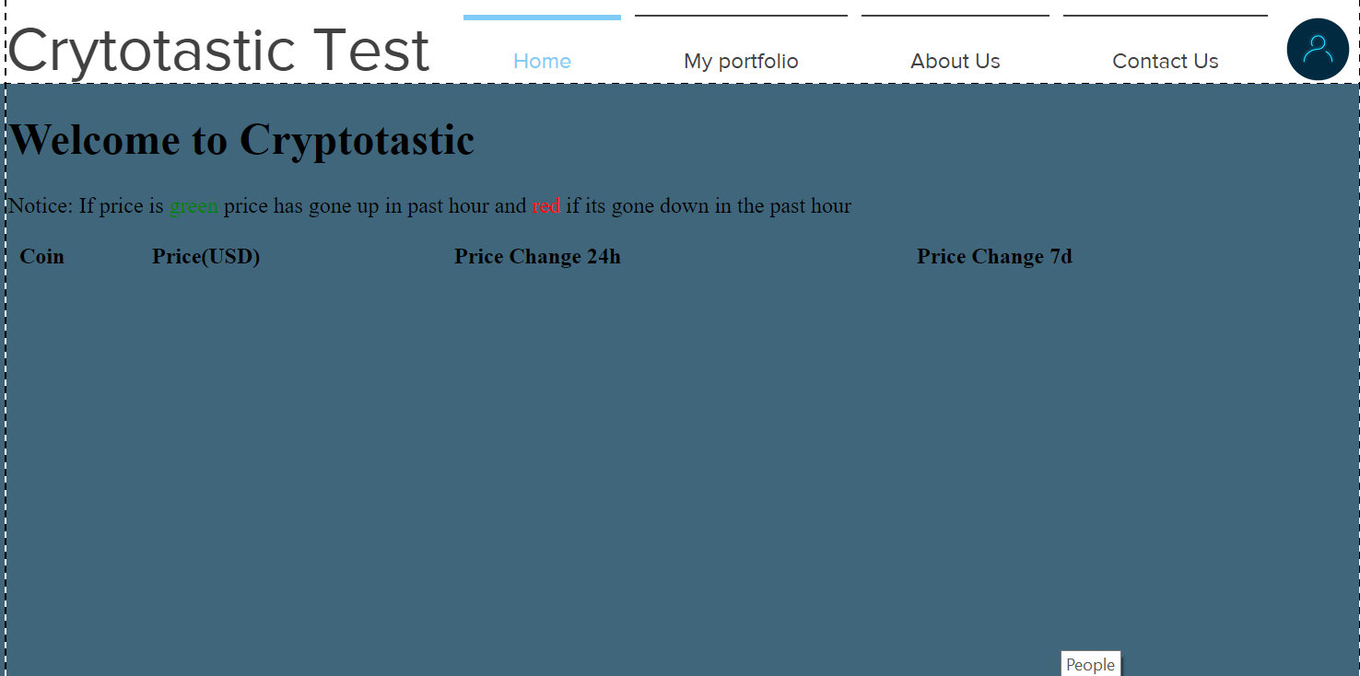
Website: progress
Daren
In this area of working towards on making website we decided it was best fit to keep a simple design but with a professional look.
Our group had done a few drafts of what the website should look like and if we were going to create the website from scratch or use a website to build the website.
So far the website consist of having a 4 pages which are the home page, the portfolio page, the about us page and the service page.
This print screen shows the draft version that I have created to show what type of style I was hoping for when designing the website.

Slide 2
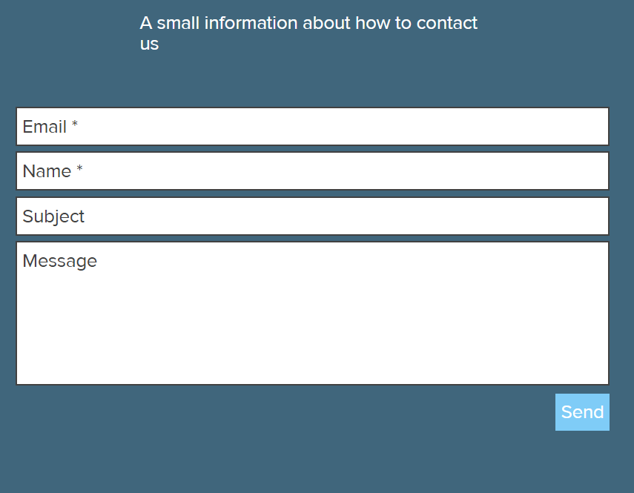
Website: progress
Daren
The main feature of the website consist of having a navigation system which allows the user to navigate around the site by using the navigation bar.
Another feature of the website would be that it has a feedback form so that we can communicate with our users on what areas should be improved.
This print screen shows a contact form so that the users are able to contact us if they have a problems with their account or have some general feedback of our website.

